Slide 1
Text-based Industry Classification
by using Autoencoder
Kyounghun Bae¹, Daejin Kim², Rocku Oh^{2*}
¹Hanyang University
²Ulsan National Institute of Science and Technology

Slide 2
Outline
Introduction
Problem statement
Methodology
Bag of Words representation
Dimensionality reduction using Autoencoder
Spherical clustering
Result
Conclusion

Slide 3
Introduction
A variety of approaches to group homogenous firms to analyze industry-based studies has been conducted.
Corporate reorganization
Changes in financial and investment policy
Credit rating
Industry classification systems
Standard Industrial Classification (SIC) uses information on selling end products and production process (Chan, Lakonishok, & Swaminathan, 2007)
Fama and French (1997) proposes 49-industry classification by merging several ranges of SIC codes.
North American Industry Classification System (NAICS)
Global Industry Classification System (GICS) is widely used by the investment analysts and portfolio managers. The system is based not only on operational characteristics of firms also on the investors’ perceptions of what constitutes the firm’s mainstream of their business (Kile & Phillips, 2009)

Slide 4
Problem Statement
To overcome the drawbacks of the previous industrial classification systems, Hoberg and Phillips (2016) propose a new text-based industry groups
The system is based on a strong tendency of vocabulary usage among firms operating in the same market(industry) reported to the Securities and Exchange Commission (SEC)
They analyze text descriptions at the level of the word(vocabulary) from the annual report
They measure the pairwise cosine similarity of the word vectors extracted from the reported document of firms
The system is able to capture the changes in firms’ business, namely diversification and pivoting as well.

Slide 5
Problem Statement
Limitation of previous approach
The similarity measure can only represent firm-to-firm information, not firm-to-industry or industry-to-industry.
Cannot infer the overall map of industry closeness and relationship although they validate the across industry variation of their final clusters.
Cosine similarity measure by high dimensional vectors cannot escape from the curse of dimensionality problem (Skillicorn, 2012).
The dimension of word vectors used in their research is larger than 60,000
The word vectors are highly sparse as well.
The distance(similarity) measure may not even be qualitatively meaningful in high dimensional space (Aggarwal, Hinneburg, & Keim, 2001).

Slide 6
Dimensionality reduction
Reducing the Dimensionality of Data with Neural Networks
(G.E Hinton* and R. R. Salakhutdinov, 2006)
High-dimensional data can be converted to low-dimensional codes by training a multilayer neural network with a small central layer to reconstruct high-dimensional input vectors.
Deep-Autoencoder networks works much better than principal components analysis as a tool to reduce the dimensionality of data
They use “Bag-of-Words” representation as input vector
The Reuters Corpus Volume II contains 804,414 newswire stories
Each article is represented as a vector containing the counts of the most frequently used 2000 words in the training dataset.

Slide 7
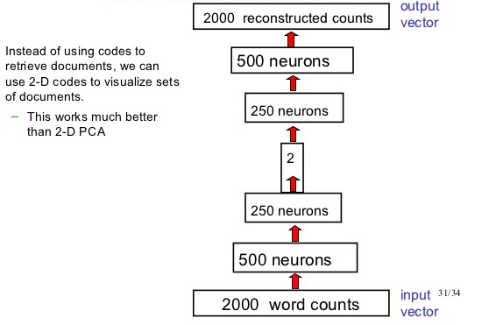
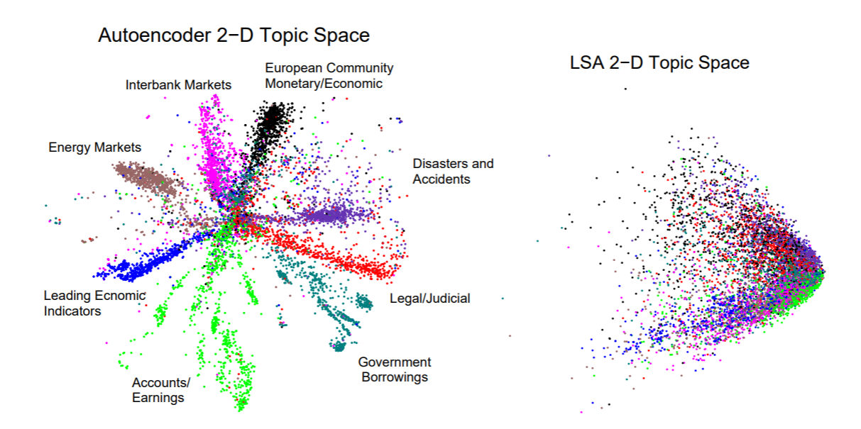
Dimensionality reduction
Reducing the Dimensionality of Data with Neural Networks
(G.E Hinton* and R. R. Salakhutdinov, 2006)
(G.E Hinton* and R. R. Salakhutdinov, 2006)

Slide 8
Data
SEC 10-K Filings
We collect 10-K annual reports filed by the Securities and Exchange Commission (SEC) from 2013 to 2016 using web crawling algorithm which results in the total number of 21,631 10-K reports.
“Item 1. Business” part contains specified product description of firms
Firm 1: SANDISK CORP (SIC code: 3572)
Business: Flash Memory Storage
Core words: memory(67), product(52), technology(44), storage(36), market(31), device(31), solution(28), NAND(26), flash(24), drive(20), manufacturer(19), design(19), corporation(18), venture(18), card(18), president(17), data(16), wafer(16), cost(15), year(15)
Firm 2: SCHEIN (HENRY) INC (SIC code: 5047)
Business: Healthcare Distribution
Core words: health(102), product(89), care(65), service(62), state(47), customer(47), law(44), practice(41), president(40), business(40), distribution(37), sale(35), drug(33), act(30), vice(30), practitioner(26), officer(25), technology(24), order(23), management(23)
Firm 3: IMPAC MORTGAGE HOLDINGS INC (SIC code: 6162)
Business: Long-term Portfolio
Core words: mortgage(174), loan(159), origination(53), portfolio(49), service(45), estate(34), operation(33), channel(33), Mae(30), interest(30), correspondent(29), lending(27), rate(27), credit(21), security(21), broker(20), sale(20), borrower(19), seller(18), act(17)

Slide 9
Methodology
Bag-of-Words representation
The underlying hypothesis is based on the notion that firms classified in the same industry use more similar words to describe and offer their business and products than the firms classified in the different industries
Unique words out of 2000 words in the bag-of-words | Occurrences
Case 1 - Healthcare, Medical Equipment, and Drugs
hospital, billing, physician, Medicaid, productivity, patient, submission, reimbursement, Medicare, referral | 9 times out of 9 documents
beneficiary, methodology, recruitment, length, abuse, accountability, authorization, accreditation, CM, associate, prohibition, utilization, therapy, transition, employer, sanction, eligibility, safeguard, notification, fraud, worker, HIPPA(Health Insurance Portability and Accountability Act), spending, portability, admission, antikickback, update | 8 times out of 9 documents
Case 2 - Oil, Gas, and Coal Extraction and Products
crude, commodity, pipeline, hydrocarbon, petroleum, transport | 8 times out of 8 documents
proximity, carrier, cleanup, liquid, pollution, barrel, index, discharge, mile, tank, basin, emergency, exploration, drilling, commerce, injection, FERC(Federal Energy Regulatory Commission), shale, formation, greenhouse, dioxide, emission, gathering, fuel | 7 times out of 8 documents

Slide 10
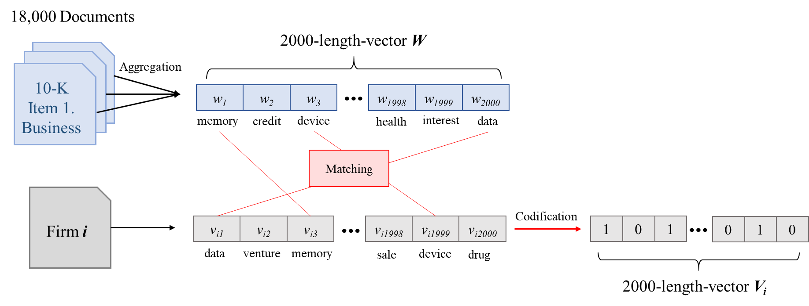
Methodology
Bag-of-Words representation
We remove common words which appear more than 20% of documents during the preprocessing.
We construct bag-of-words vector W which uses 2000-unique-word in order of frequent appearance among all the unique words.
A business description of given firm i is converted to a 2000-dimensional binary (coded) vector V_{i}

Slide 11
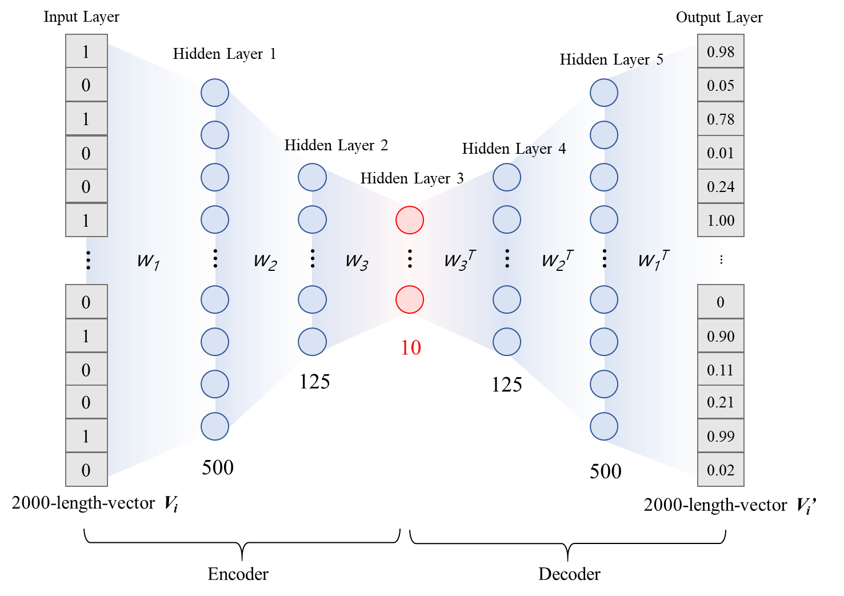
Methodology
Dimensionality reduction by using the autoencoder
This high dimensional and sparse vector space arises an issue of the curse of dimensionality when computing the cosine similarity and applying it to the clustering method directly.
We reduce the number of dimensions of feature while minimizing the cross entropy between the input vector and the reconstructed output vector

Slide 12
Methodology
Industry classification by the Spherical K-means clustering
The direction of a word vector is more important than the magnitude itself
We use spherical K-means clustering algorithm which is a suitable for the vector space model
The spherical k-means algorithm maximizes the average cosine similarity within the clusters.

Slide 13
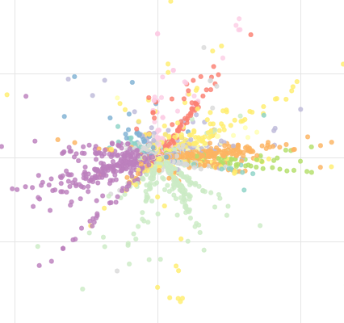
Result
Two-dimensional representation of industry space
2D scatter plot for values from the last encoding layer after training
Oil, Gas, and Coal Extraction and Products
Utilities
Consumer Nondurables
Chemicals and Allied Products
Others
Consumer Durables
Manufacturing
Business Equipment
Telephone and Television Transmission
Healthcare, Medical Equipment, and Drugs
Wholesale, Retail, and Some Services
Finance

Slide 14
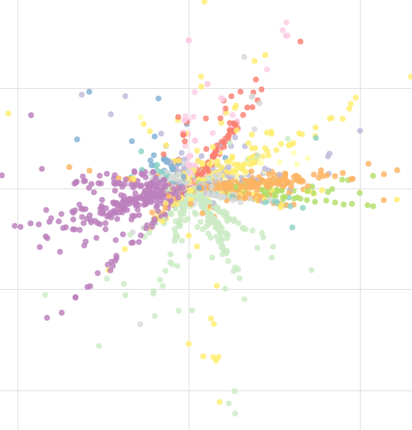
Result
Qualitative Analysis : Case 1 (Healthcare-related industry)
Some firms related to healthcare products and process are within the purple ellipse along the similar direction (angle).
The SIC code of firm “TEAM HEALTH HOLDINGS INC” is 7363 (Fama-French classification code 12; Others). “WELLCARE HEALTH PLANS INC” is coded as the SIC code of 6324 (Fama-French classification code 11; Money).
The two firms are clustered in the same industry based on the spherical K-means clustering method.
The other firms clustered with the two firms have SIC code range of 8000-8099 (Health Service).
provides outsourced healthcare professional staffing and administrative services to hospitals
TEAM HEALTH HOLDINGS INC
WELLCARE HEALTHCARE PLANS INC
provides managed care services for government-sponsored health care programs
Healthcare Services
CROSS COUNTRY HEALTHCARE INC
SELECT MEDICAL CORP
HCA HODLINGS INC
VANGUARD HEALTH SYSTEMS INC
KINDERED HEALTHCARE INC
COMMUNITY HEALTH SYSTEMS INC
HEALTH MANAGEMENT ASSOCIATES INC

Slide 15
Result
Qualitative Analysis : Case 2 (Energy-related industry)
Firms with in the red ellipse is related to the energy and mining industry including oil, gas, and materials.
“GENESIS ENERGY LP” and “HOLLY ENERGY PARTNERS LP” belong to “Shops” in terms of the Fama-French classification code (9) and SIC code(5171)
The scatter point of the two firms are closer to the “Energy” firms
GENESIS ENERGY LP
HOLLY ENERGY PARTNERS LP

Slide 16
Result
Qualitative Analysis : Case 3 (Sub-industry issue)
Four or five sub-groups are seen within financial industry colored as a green dashed-circle.
Each spike indicates different clusters in terms of the word presented in their business descriptions even though the firms are all related to money or financial industry
The firms located in the green ellipse is one of the sub-groups of financial industry. The sub-industry is closer to the industry group in the purple circle (Case 1 group) than other sub-groups within the financial industry
Most of the firms in Case 1 groups are deals with the insurance related to healthcare.
Security Brokers, Dealers, and Flotation Companies
GOLDMAN SACHS GROUP INC
MORGAN SYANLEY
INTERACTIVE BROKERS GROUP INC
INTERCONTINENTAL EXCHANGE INC
CBOE HOLDINGS
CME GROUP INC
NASDAQ OMX GROUP INC
Insurance and Real Estates
EVEREST RE GROUP LTD
AMERISAFE INC
AXIS CAPITAL HOLDINGS LTD
ALLIED WORLD ASSURANCE CO HOLDINGS AG
FIRST ACCEPTANCE COPR DE
EMPLOYEE HOLDINGS INC
PARTNER RE DTD

Slide 17
Result
Quantitative Analysis
Within-industry variation
Compute standard deviation of individual groups by year→ Compute an industry-size-weighted average of the standard deviations
Smaller is the better
Across-industry variation
Compute the firm-size-weighted average of individual groups by year → Compute a standard deviation of the averages
Larger is the better
 |  | Within-industry variations |  |  | Across-industry variations
Classification method | N | Weighted OI/asset | Weighted OI/sales | Weighted Market β | Weighted OI/asset | Weighted OI/sales | Weighted Market β
SIC 3-digit | 245 | 0.126 | 18.296 | 0.884 | 0.390 | 0.066 | 0.741
GICS_subind | 157 | 0.143 | 13.823 | 0.803 | 3.455 | 0.136 | 0.619
TNIC 300 fixed code | 300 | 0.130 | 10.243 | 0.980 | 4.493 | 0.139 | 0.809
Autoencoder + SKmeans | 300 | 0.113 | 5.857 | 0.856 | 10.819 | 0.150 | 0.924
TNIC |  | 0.124 | 8.655 | 1.055 | 0.125 | 19.081 | 0.678
Autoencoder + TNIC |  | 0.132 | 4.250 | 0.996 | 0.115 | 20.103 | 0.703

Slide 18
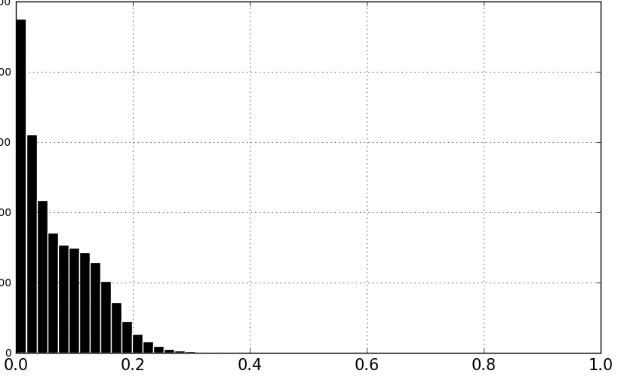
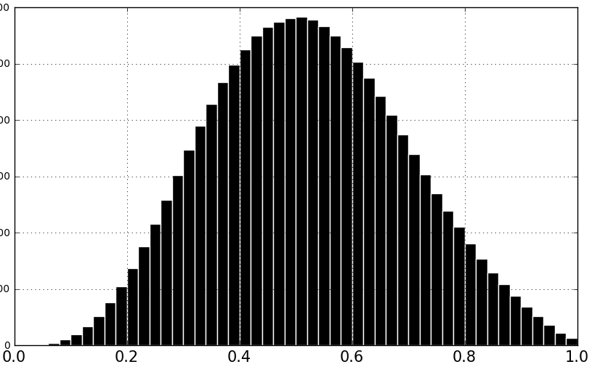
Result
Quantitative Analysis
Cosine Similarity
TNIC similarity scores are highly skewed. The fact indicates computing a cosine similarity measure of high dimensional vectors directly is inappropriate, causing curse of dimensionality problem.
Density (# of pairs)
Cosine similarity (TNIC)
Cosine similarity (Autoencoder)
Classification method | Mean | Standard Deviation | Min | Max
TNIC | 0.073 | 0.063 | 0.000 | 0.904
Autoencoder | 0.521 | 0.173 | 0.011 | 0.988

Slide 19
Conclusion
We collect 10-K annual reports from the Securities and Exchange Commission (SEC) using web crawling algorithm to extract business description text data of each firm.
We use a deep learning method, which is called autoencoder, as a dimensionality reduction technique to reduce the dimension of original high dimension and sparse word vector to mitigate a curse of dimensionality problem in vector space.
We clusters firms using the reduced features by spherical K-means clustering algorithm which is a suitable for the vector space model.
We are able to visualize similarity and closeness between industries as well as firms.
We qualitatively shows several mis-classified firms by proposed method and visualization.
We quantitatively validate the performance of proposed method by within and across the variations of clusters(industries)

Slide 20
Thank you
감사합니다

Slide 21
Further research
Clustering Method
Optimal # of words for BOW
Optimal # of clusters (industries)
Optimal # of node(features) of encoder
Clustering result are based on NOUNS only
Clustering result
focus on firms in same product and process chain
Spanning the level of a token – Include verbs and several words as a token
We produce corn chips from micro kernels that our customers sell by wholesale.
We sell by wholesale micro chips and kernels that our customers use to produce corn.
Novel technique to convert documents to vector notation
E.g. ) Doc2Vec with Deep Convolutional Autoencoder

Slide 22
Appendix

Slide 23
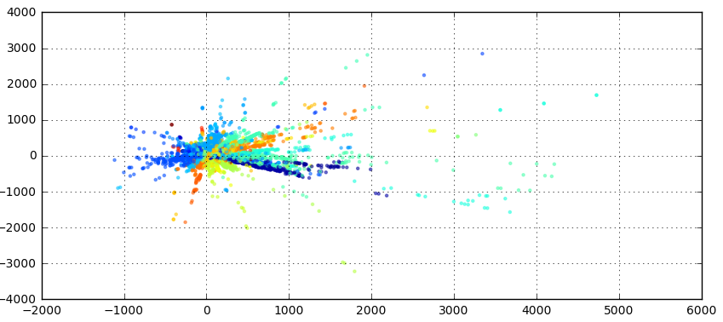
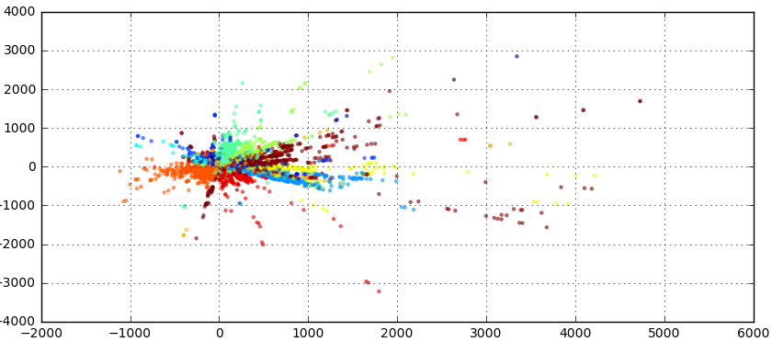
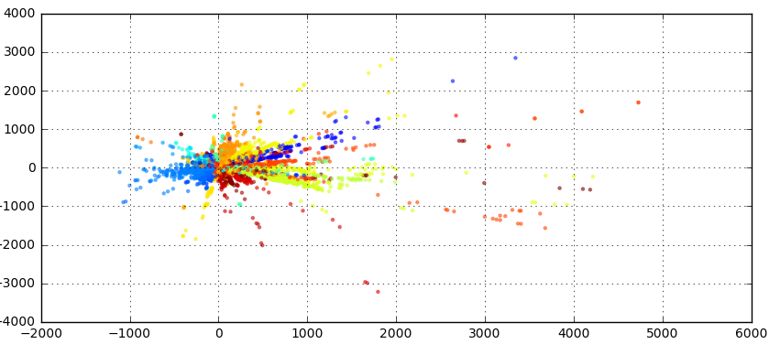
Appendix
Comparison between classification systems
2-digit SIC code (# = 64)
Fama-French 49 Industry classification code
# = 64
# = 12
# = 49

Slide 24
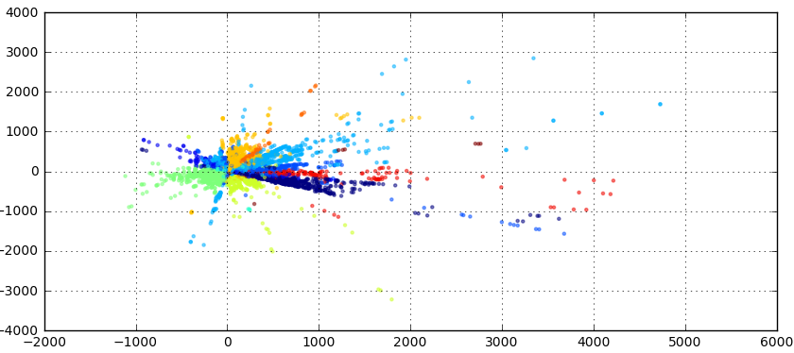
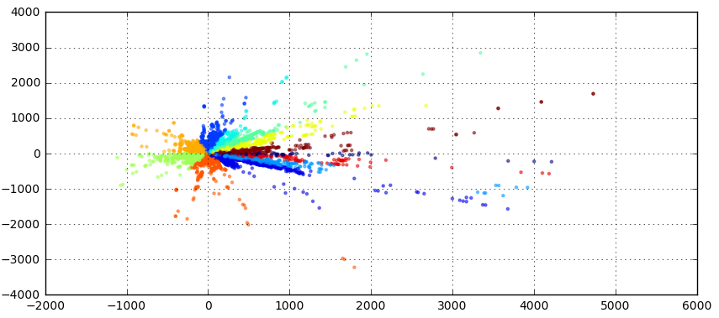
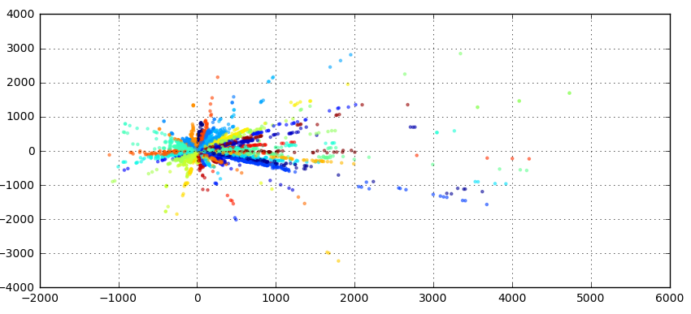
Appendix
Comparison between classification systems
GICS (# = 70)
Spherical k-means clustering
# = 70
# = 12
# = 50

Slide 25
Appendix
Table 1. Sample firms having different SIC code ranges but allocated to the same label of cluster.
Firm name | SIC code | Fama-French 12 Classification code |  | Clustered code
Case 1 - Healthcare, Medical Equipment, and Drugs
TEAM HEALTH HOLDINGS INC | 7363 | 12 | Others | 11
WELLCARE HEALTH PLANS INC | 6324 | 11 | Money | 11
SELECT MEDICAL HOLDINGS CORP | 8069 | 10 | Hlth | 11
SYMBION INC TN | 8011 | 10 | Hlth | 11
LHC GROUP INC | 8082 | 10 | Hlth | 11
LIFEPOINT HOSPITALS INC | 8062 | 10 | Hlth | 11
TENET HEALTHCARE CORP | 8062 | 10 | Hlth | 11
AMN HEALTHCARE SERVICES INC | 8090 | 10 | Hlth | 11
HCA HOLDINGS INC | 8062 | 10 | Hlth | 11
Case 2 - Oil, Gas, and Coal Extraction and Products
GENESIS ENERGY LP | 5171 | 9 | Shops | 4
CROSSTEX ENERGY LP | 5172 | 9 | Shops | 4
HOLLY ENERGY PARTNERS LP | 4613 | 12 | Others | 4
GULFPORT ENERGY CORP | 1311 | 4 | Energy | 4
CONTINENTAL RESOURCES INC | 1311 | 4 | Energy | 4
UNIT CORP | 1311 | 4 | Energy | 4
MID CON ENERGY PARTNERS LP | 1311 | 4 | Energy | 4
CHEVRON CORP | 2911 | 4 | Energy | 4

